Slide 1


Improve query performance with the new SQL Server 2016 query store!!
Michelle Gutzait
Principal Consultant at www.Pythian.com
gutzait@Pythian.com

Slide 2





T-SQL performance analysis and tuning
Something is broken
DB is too slow
Timeouts
Application crashes
Weird behavior

Slide 3

The approach
Where to start?
Which tools to use?
How to identify heavy T-SQL?

Slide 4
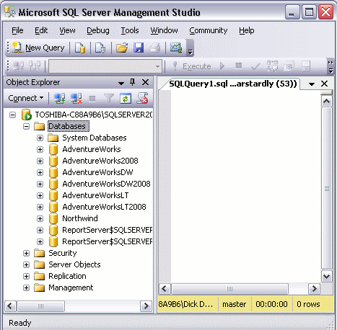

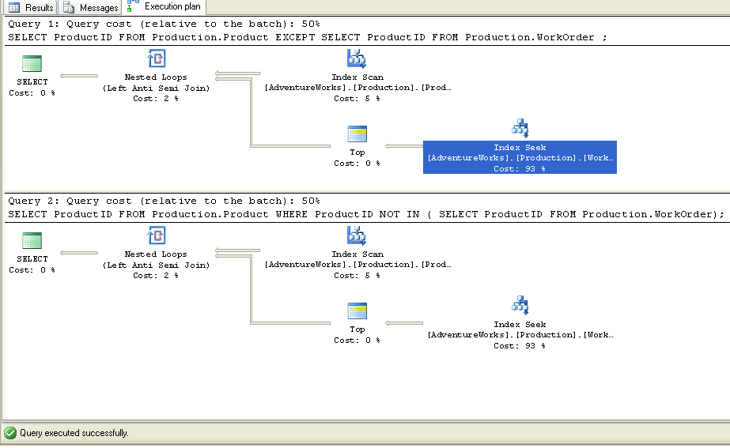
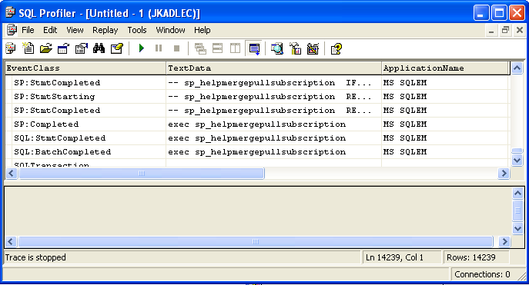
Tools – SQL Server
SQL Server Profiler &
SQL Traces
ReadTrace (RML utility) – command line
SQL Server Management Studio
Sp_who2 and Dbcc inputbuffer (<spid>)
Scripts

Slide 5
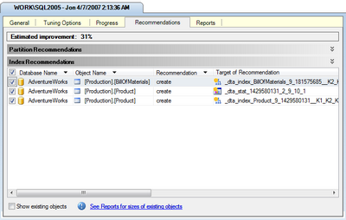
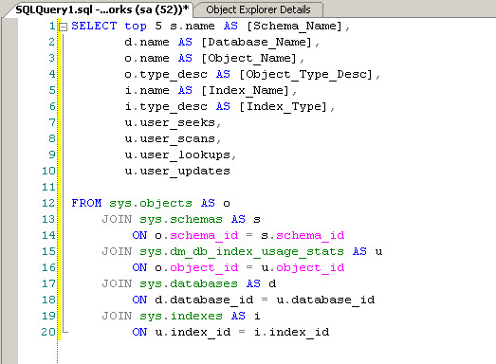
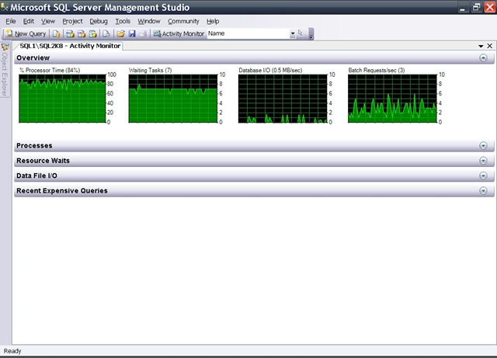
Tools – SQL Server (2)
Database Engine Tuning Advisor
DMVs and statistics
SQL Server Activity Monitor

Slide 6
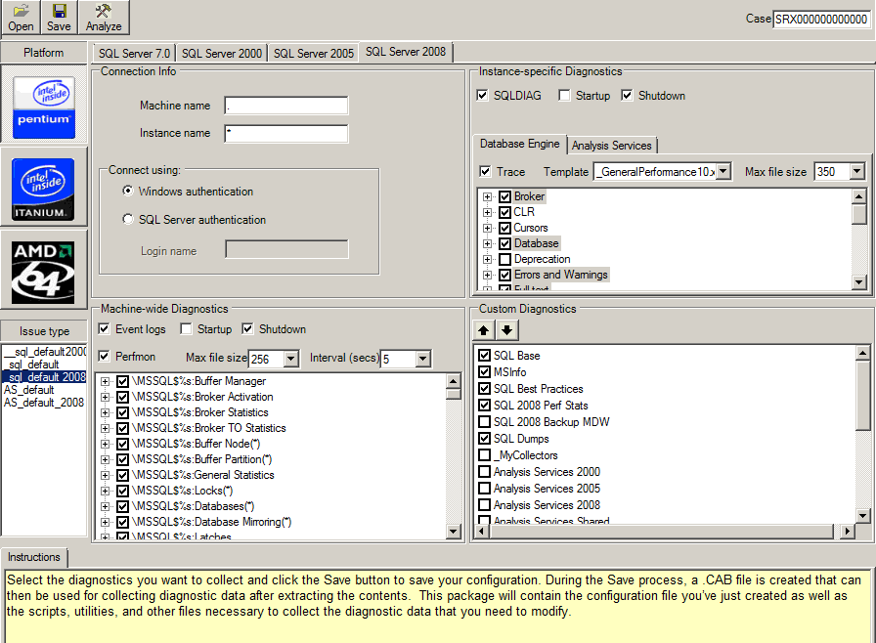
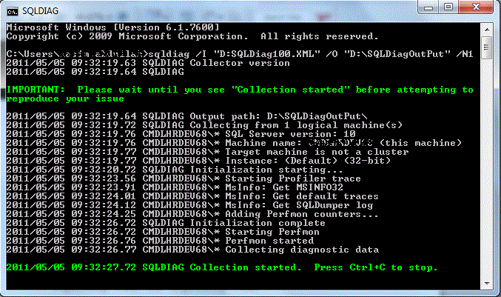
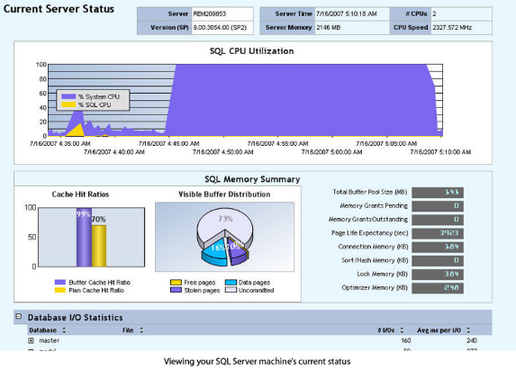
Tools – SQL Server (3)
PSSDiag
SQLDiag and PerfStats
SQL Nexus

Slide 7
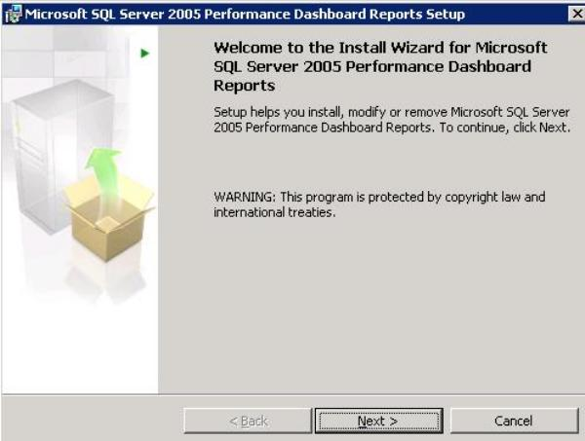
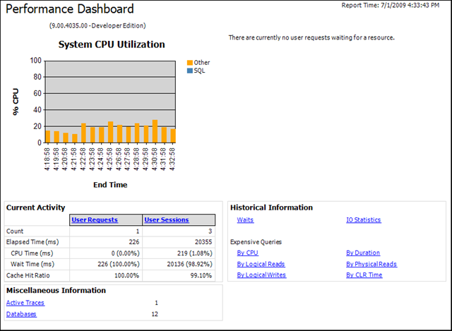
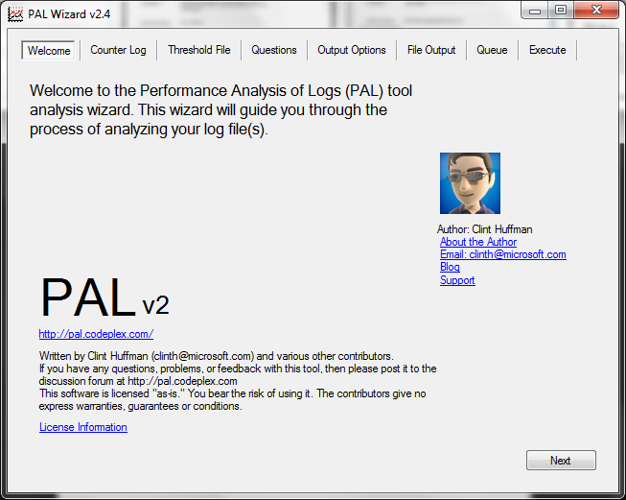
Tools – SQL Server (4)
Performance Dashboard
Performance Analysis of Logs (PAL)

Slide 8
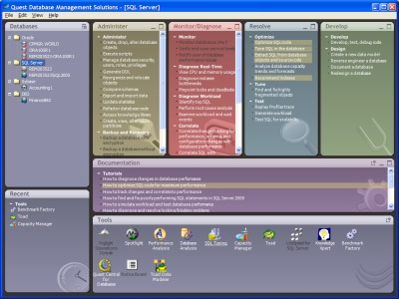
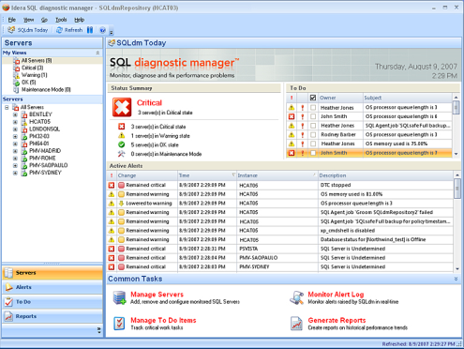
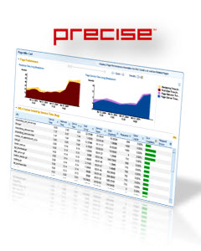

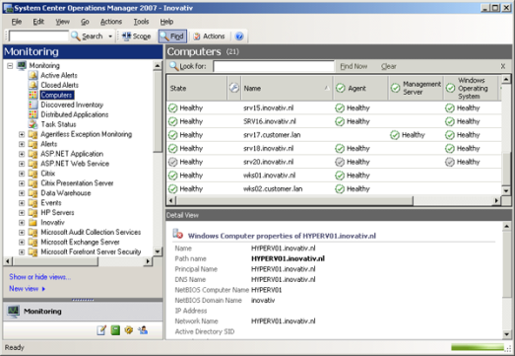
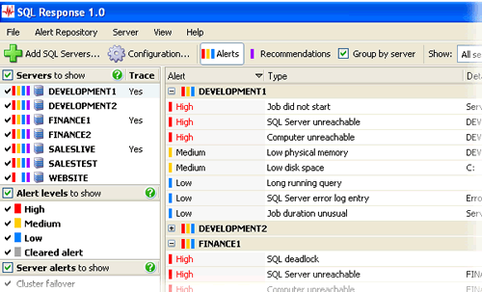

3-rd party tools

Slide 9

Retroactive T-SQL analysis before SQL Server 2016…

Slide 10
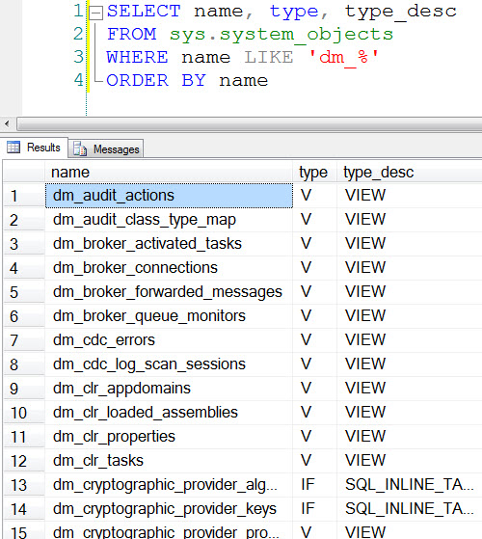
Dynamic Management Views (DMVs)
Cleared up from Cache when:
Manually
SQL Server is restarted
Statistics are updated
Memory pressure
…

Slide 11
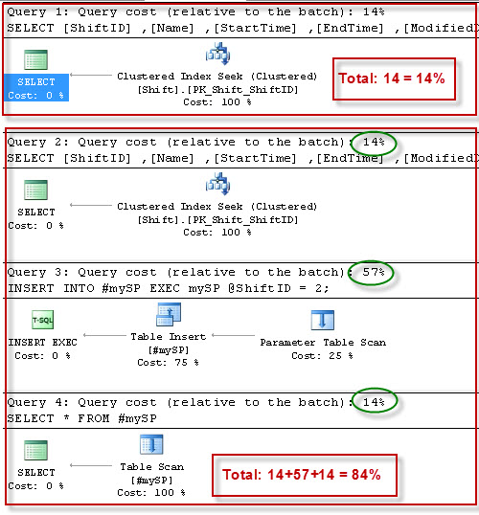
Example DMV - sys.dm_exec_query_plan Execution plans
Query plans for cached batches or are currently executing
No versioning
No history

Slide 12
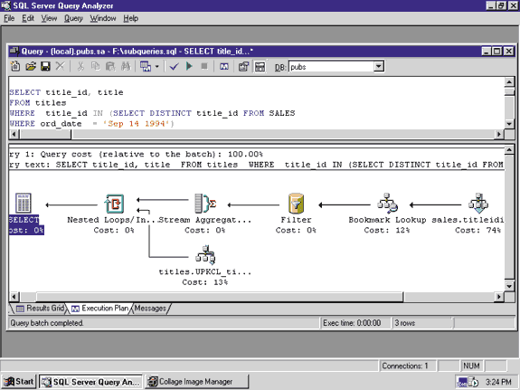
So to get the correct Execution Plan
The solution include:
T-SQL code re-write
Example: use #tmp
Query hints
Plan guides
Statistics
Indexes
sp_configure settings
…

Slide 13

So to get Execution plan history…
Use performance monitoring software
Execution plans of all queries
Keep history
Use scripts to capture history from DMVs
SQL Traces
…

Slide 14

New “feature” – Query Store… New approach?
Community Technology Preview (CTP)

Slide 15
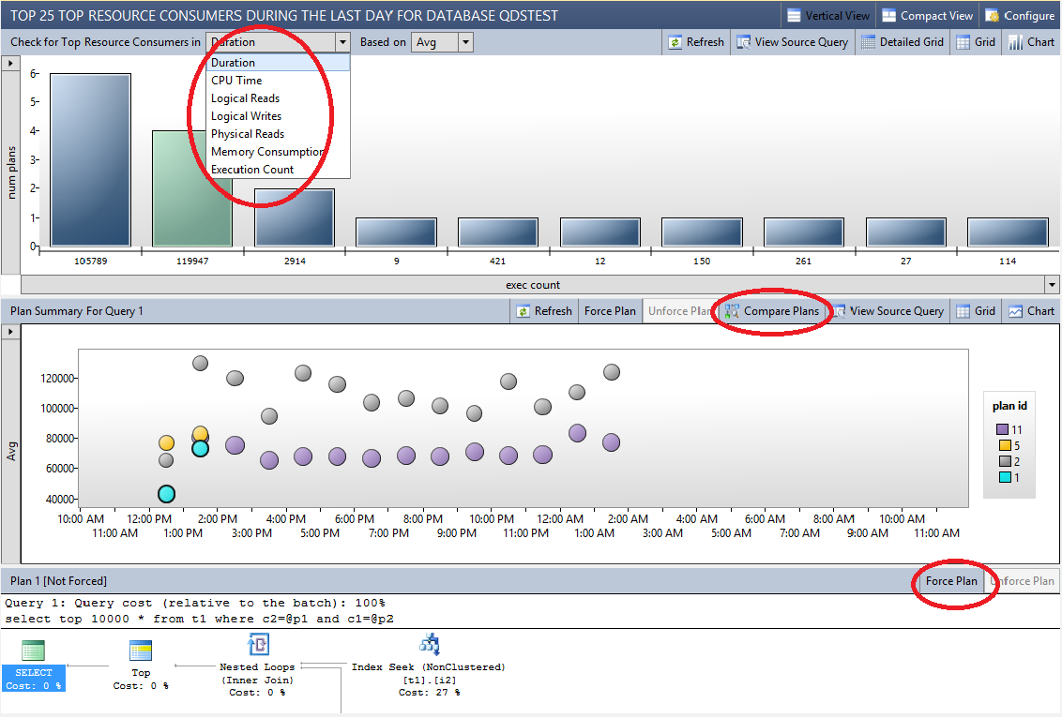
This presentation
Introduces the Query Store
Explains the architecture
Shows how it can be used to solve real-world performance problems

Slide 16
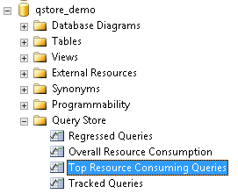
SQL Server’s new Query Store
Tracks:
Query plans
Runtime statistics
Queries/plans history
Helps find regressing queries
Quickly find new queries with multiple plans
Identify un-efficient plans so you can force a better plan

Slide 17
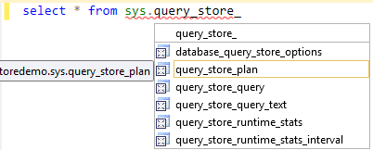
SQL Server’s new Query Store
Saves history of queries and execution plans
Even after SQL Server restart
The current and previous plans will be exposed in a DMV

Slide 18
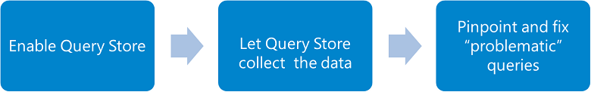
How to use
Configure

Slide 19
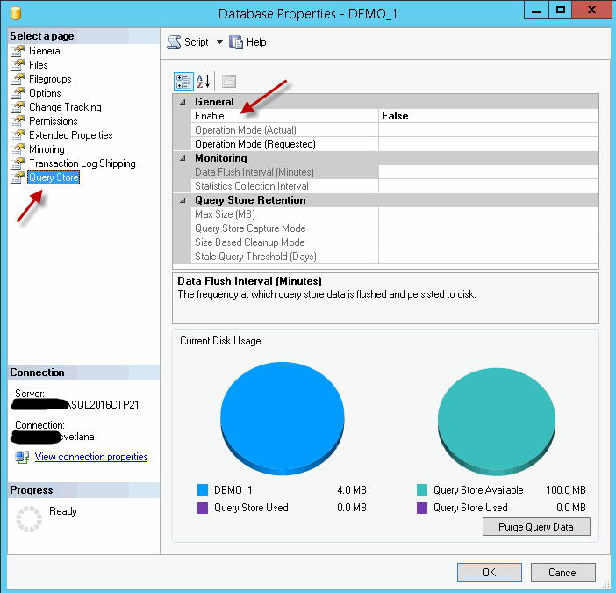
Enable Query Store

Slide 20
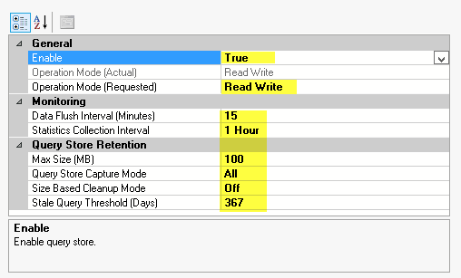
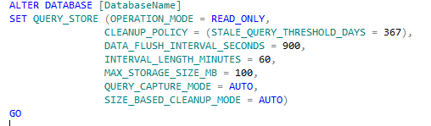
Configure Query Store
Read_only vs. Read_Write
Max_Storage_size

Slide 21
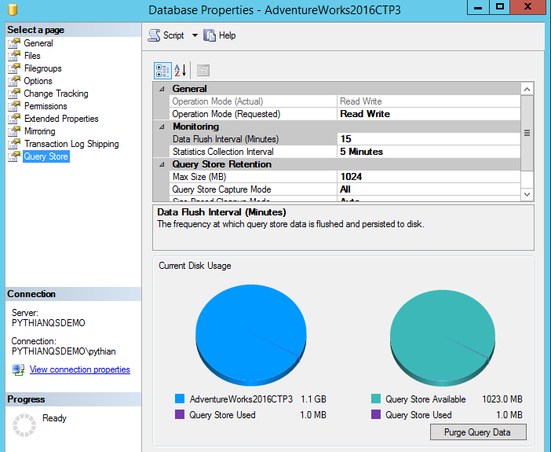
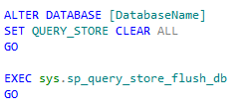
View disk usage space

Slide 22
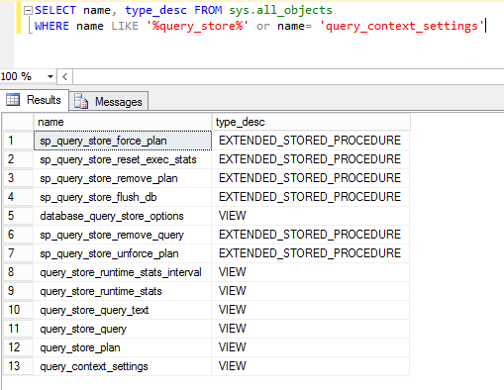
Query Store System Objects and New Extended Events
SPs: https://msdn.microsoft.com/en-us/library/dn818153.aspx
Catalog views: https://msdn.microsoft.com/en-us/library/dn818149.aspx.

Slide 23
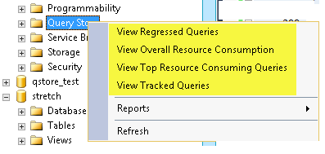

Query Store container in SSMS

Slide 24
Query Store “reports”
SSMS view | Scenario
Regressed Queries | Pinpoint queries for which execution metrics have recently regressed (i.e. changed to worse). Use this view to correlate observed performance problems in your application with the actual queries that needs to be fixed or improved.
Top Resource Consuming Queries | Choose an execution metric of interest and identify queries that had the most extreme values for a provided time interval. Use this view to focus your attention on the most relevant queries which have the biggest impact to database resource consumption.
Tracked Queries | Track the execution of the most important queries in real-time. Typically, you use this view when you have queries with forced plans and you want to make sure that query performance is stable.
Overall Resource Consumption | Analyze the total resource consumption for the database for any of the execution metrics. Use this view to identify resource patterns (daily vs. nightly workloads) and optimize overall consumption for your database.

Slide 25

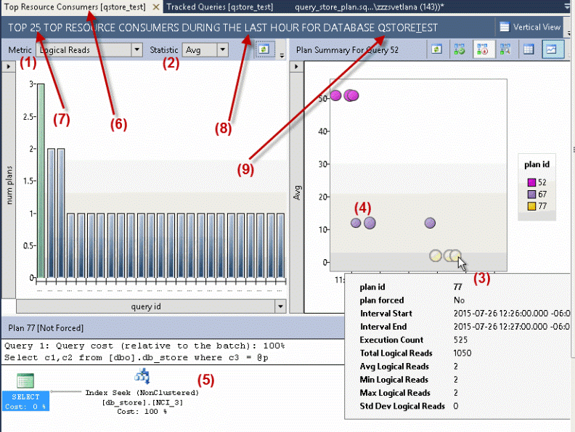
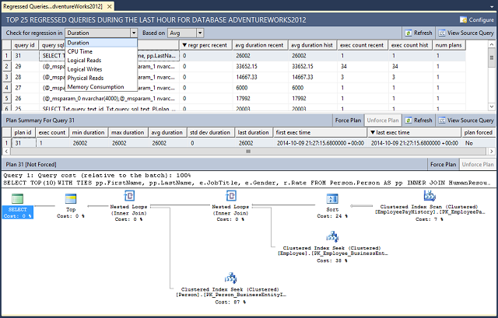
Regressed Queries

Slide 26

Demo

Slide 27
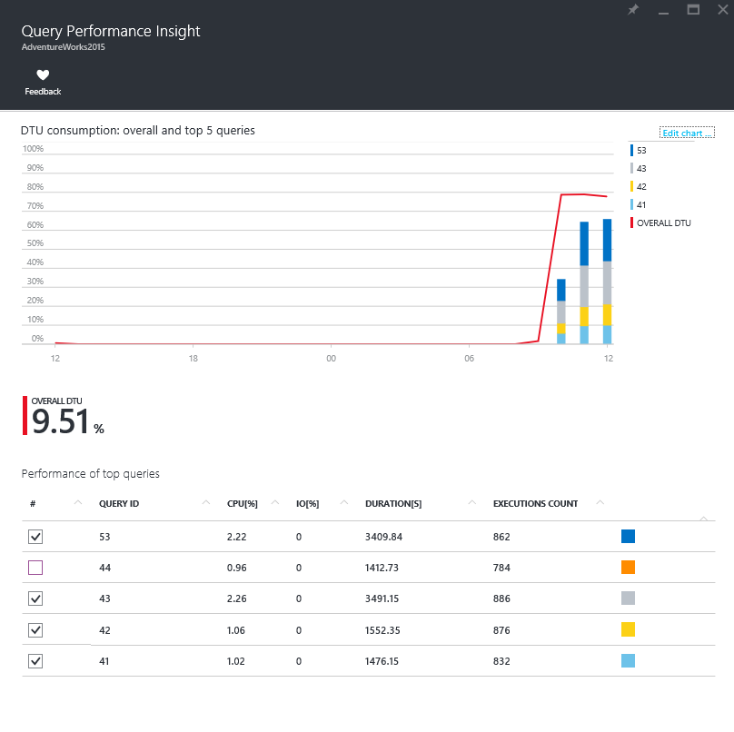
Best Practices
https://msdn.microsoft.com/en-CA/library/mt604821.aspx#Configure
Use latest SSMS
Use Query Performance Insight in Azure SQL Database
Keep Query Store Adjusted to your Workload
Max size
Collection interval
Retention period (per query and overall)

Slide 28

Best Practices (2)
Verify Query Store is Collecting Query Data Continuously
Silent mode change
Avoid using Non-parameterized queries
To avoid frequent recompiles

Slide 29
Non-Parameterized Queries
Parameterize queries where applicable, for example wrap queries inside a stored procedure.
Use the Optimize for Ad Hoc Workloads option if your workload contains many single use ad-hoc batches with different query plans.
Compare the number of distinct query_hash values with the total number of entries in sys.query_store_query. If the ratio is close to 1 your ad-hoc workload generates different queries.
Apply FORCED PARAMETERIZATION, for the database or for a subset of queries if the number of different query plans is not large.
Use plan guide to force parameterization only for the selected query.
Configure FORCED PARAMETERIZATION for the database, if there are a small number of different query plans in your workload. (When the ratio between the count of distinct query_hash and the total number of entries in sys.query_store_query is much less than 1.)
Set the Query Capture Mode to AUTO to automatically filter out ad-hoc queries with small resource consumption.

Slide 30
Best Practices (3)
Avoid recreating stored procedure, function, and trigger or renaming databases
Check the Status of Forced Plans Regularly

Slide 31

Thank you! gutzait@Pythian.com

Slide 32
Answers to questions raised during the session
Q: Permissions to view only query store (for developers)
A: I could not find any answer to this question but for sure if you are dbo in the database you can do anything with the query store. I will need to play around with permissions for more details. I will publish such an article on the Pythian site. Stay tuned!

